Slide 1
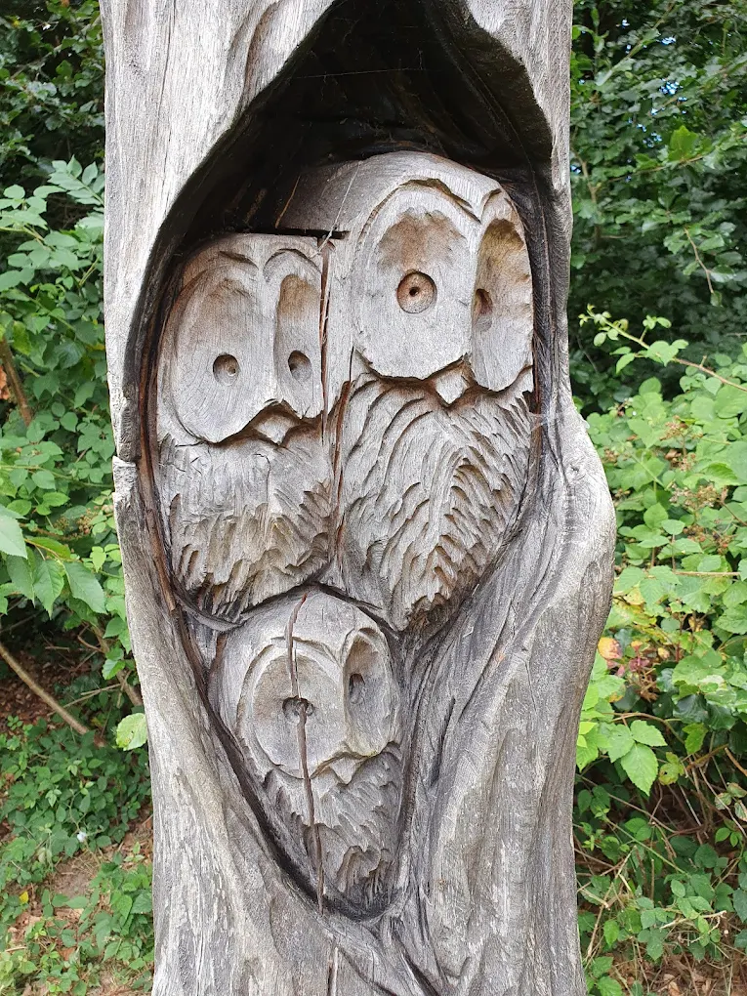


Photography Exhibition
Photographs of
Little Chalfont Nature Park
taken by students of Challoner’s High
Little Chalfont Village Hall
Thursday 9 July 2026
1400 - 1700
Open to ALL
students, parents, staff and
the public
With kind support from Cytiva
Cokes Lane,
Little Chalfont,
Amersham HP8 4UD

